Slide 1
15-780 – Graduate Artificial Intelligence:
Markov Decision Processes
Aditi Raghunathan
Carnegie Mellon University
Spring 2023

Slide 2
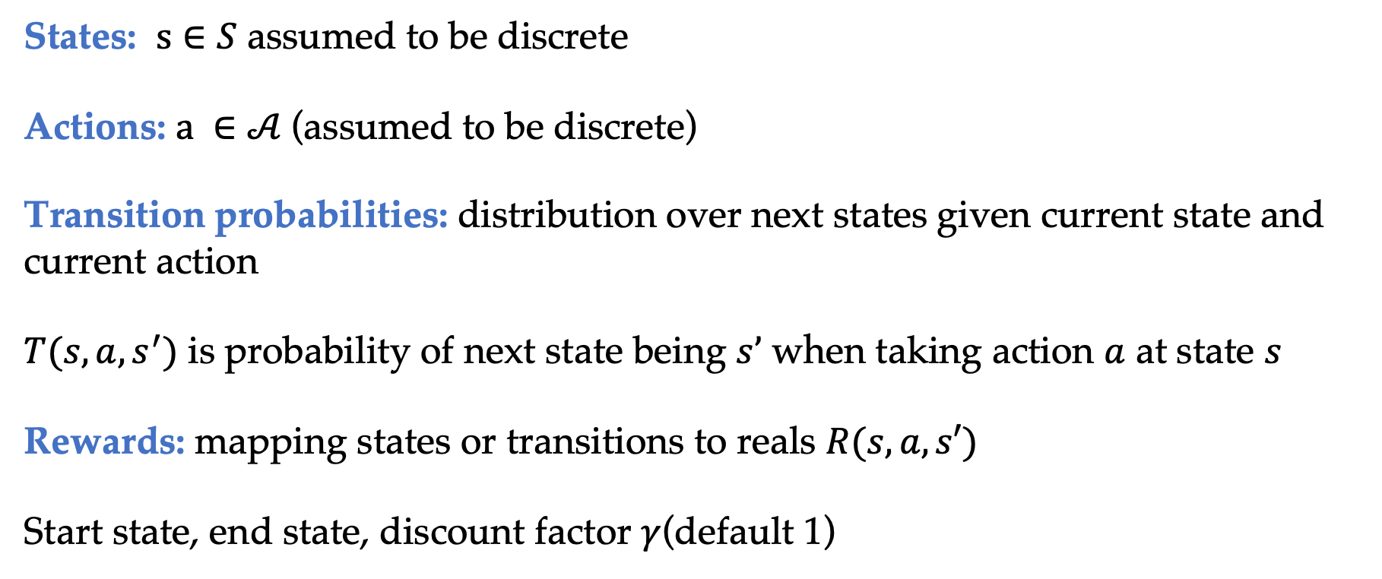
MDPs formal definition
States: $s∈S$ assumed to be discrete
Actions: $a ∈𝒜$(assumed to be discrete)
Transition probabilities: distribution over next states given current state and current action
$T(s, a, s^{′})$ is probability of next state being $s’$ when taking action $a$ at state $s$
Rewards: mapping states or transitions to reals $R(s, a, s′)$
Start state, end state, discount factor $γ$(default 1)

Slide 3
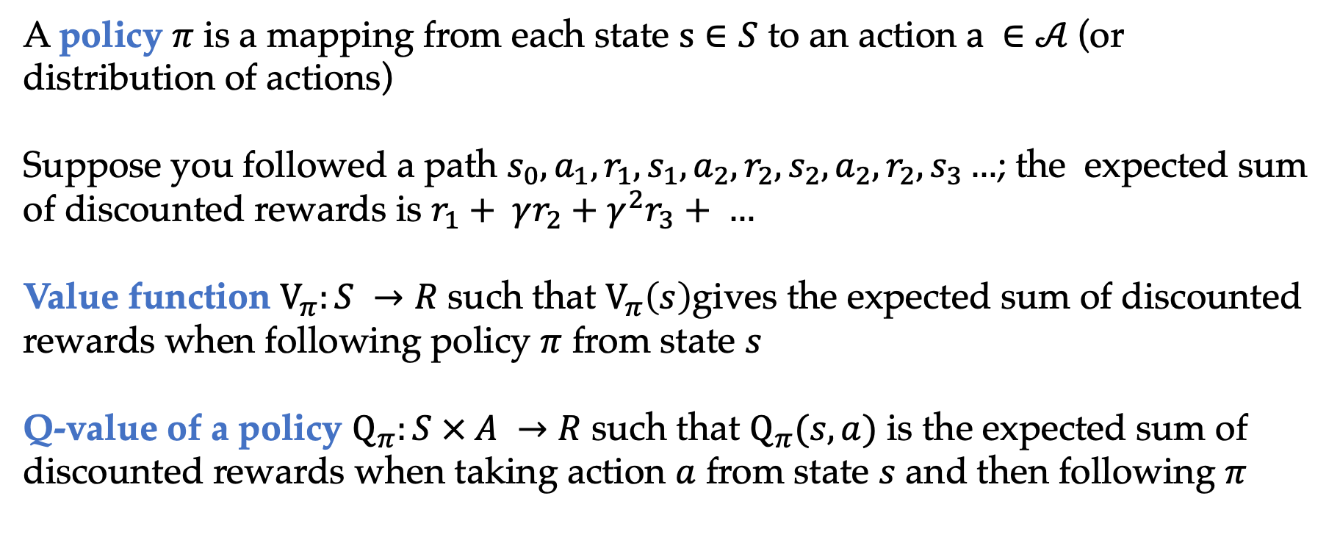
Policy and policy evaluation
A policy $π$ is a mapping from each state $s∈S$ to an action $a ∈𝒜$(or distribution of actions)
Suppose you followed a path $s_{0},a_{1},r_{1},s_{1},a_{2},r_{2}, s_{2},a_{2},r_{2}, s_{3}…$; the expected sum of discounted rewards is $r_{1}+ γr_{2}+γ^{2}r_{3}+ …$
Value function $V_{π}:S →R$ such that $V_{π}\left(s\right)$gives the expected sum of discounted rewards when following policy $π$ from state $s$
Q-value of a policy $Q_{π}:S × A →R$ such that $Q_{π}(s, a)$ is the expected sum of discounted rewards when taking action $a$ from state $s$ and then following $π$

Slide 4
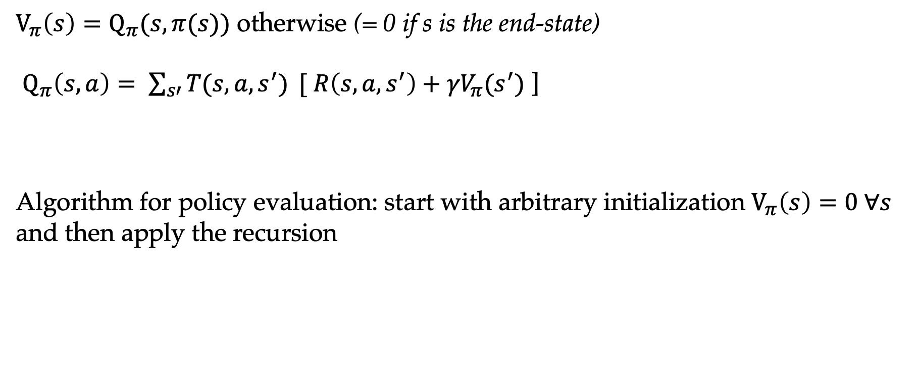
Recursive definitions
$V_{π}\left(s\right)=Q_{π}(s,π(s))$ otherwise (= 0 if s is the end-state)
$Q_{π}\left(s,a\right)= \sum_{s′}{T(s, a, s^{′})} {[ R\left(s, a, s^{′}\right)+γV}_{π}(s^{′})$ ]
Algorithm for policy evaluation: start with arbitrary initialization $V_{π}\left(s\right)=0 ∀s$ and then apply the recursion

Slide 5
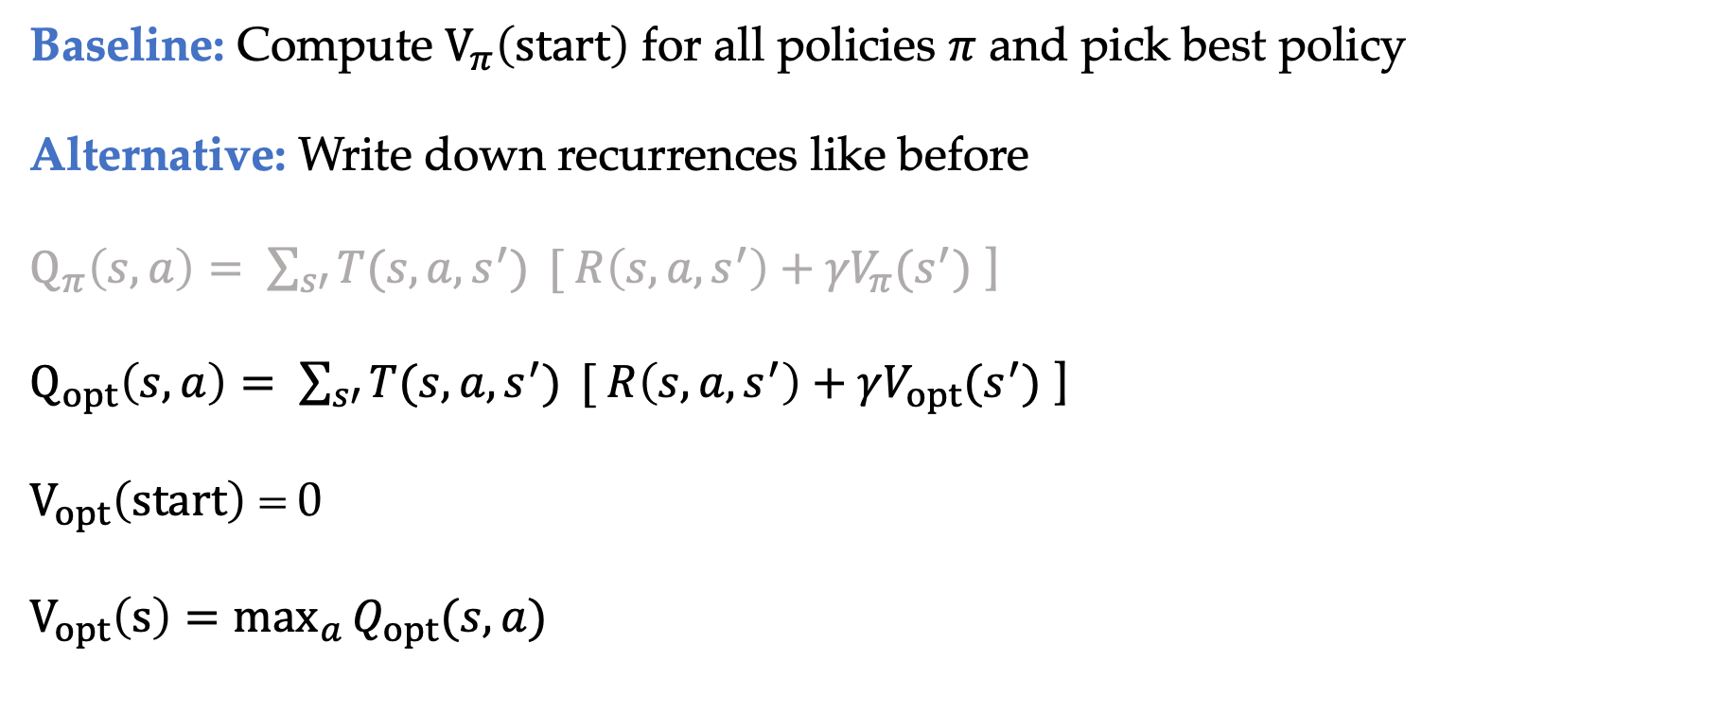
How to find best policy?
Baseline: Compute $V_{π}\left(start\right)$ for all policies $π$ and pick best policy
Alternative: Write down recurrences like before
$Q_{π}\left(s,a\right)= \sum_{s′}{T(s, a, s^{′})} {[ R\left(s, a, s^{′}\right)+γV}_{π}(s^{′})$ ]
$Q_{opt}\left(s,a\right)= \sum_{s′}{T(s, a, s^{′})} {[ R\left(s, a, s^{′}\right)+γV}_{opt}(s^{′})$ ]
$V_{opt}\left(start\right)$ = 0
$V_{opt}\left(s\right)=\max_{a}{Q_{opt}(s, a)}$

Slide 6
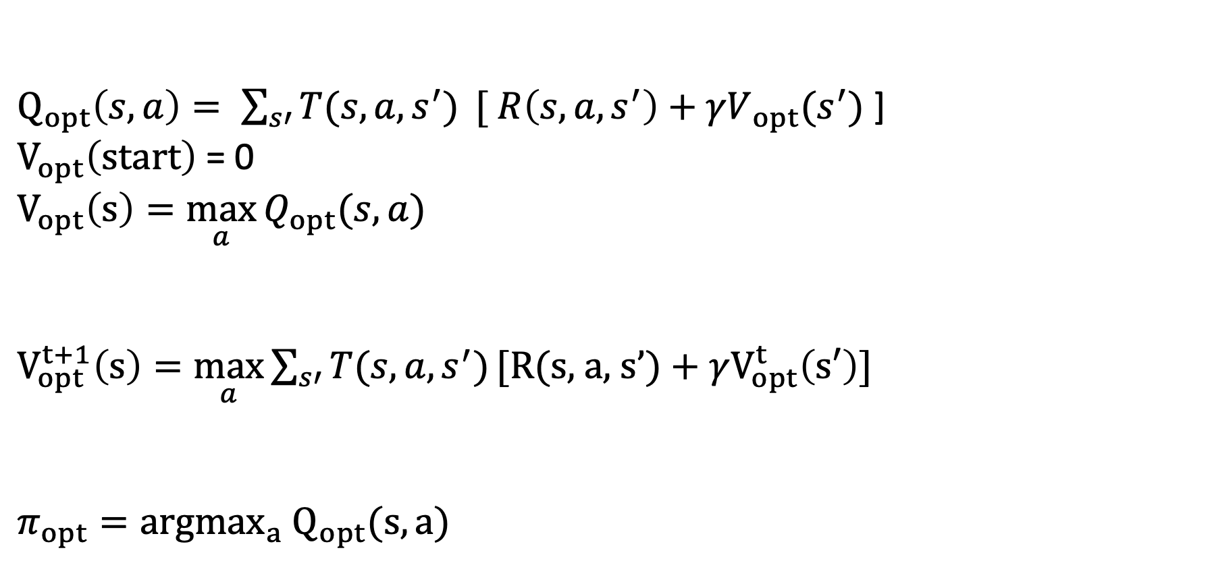
Value iteration
$Q_{opt}\left(s,a\right)= \sum_{s′}{T(s, a, s^{′})} {[ R\left(s, a, s^{′}\right)+γV}_{ opt}(s^{′})$ ]
$V_{opt}\left(start\right)$ = 0
$V_{opt}\left(s\right)=\max_{a}{Q_{opt}(s, a)}$
$V_{opt}^{t+1}\left(s\right)=\max_{a}{\sum_{s′}{T(s, a, s^{′})}\text{[}\text{R}\text{(}\text{s}\text{, }\text{a}\text{, }\text{s}’)+γV_{opt}^{t}\left(s′\right)\text{]}}$
$π_{opt}={argmax}_{a} Q_{opt}(s, a)$

Slide 7
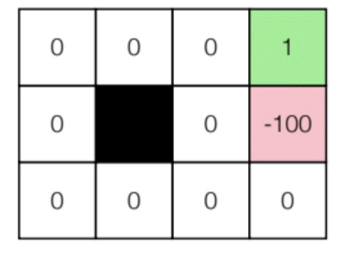
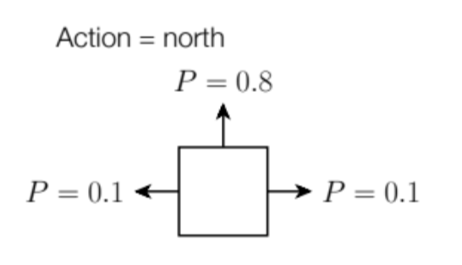
Gridworld domain
Simple grid world with a goal state with reward and a “bad state”with reward -100
Actions move in desired direction with probability 0.8 and one of two perpendicular directions with probability 0.1 each
Taking an action that bumps into a wall leaves agent where it is

Slide 8
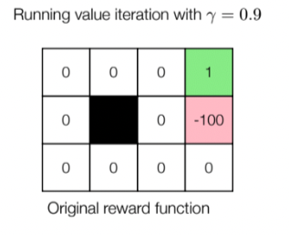
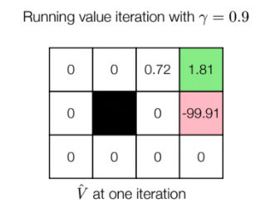
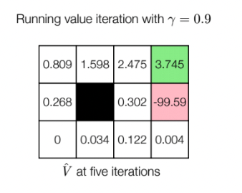
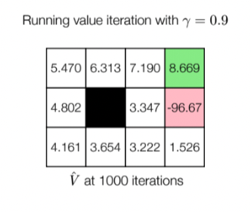
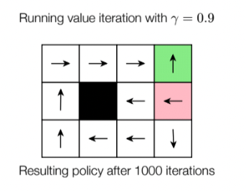
Value iteration

Slide 9

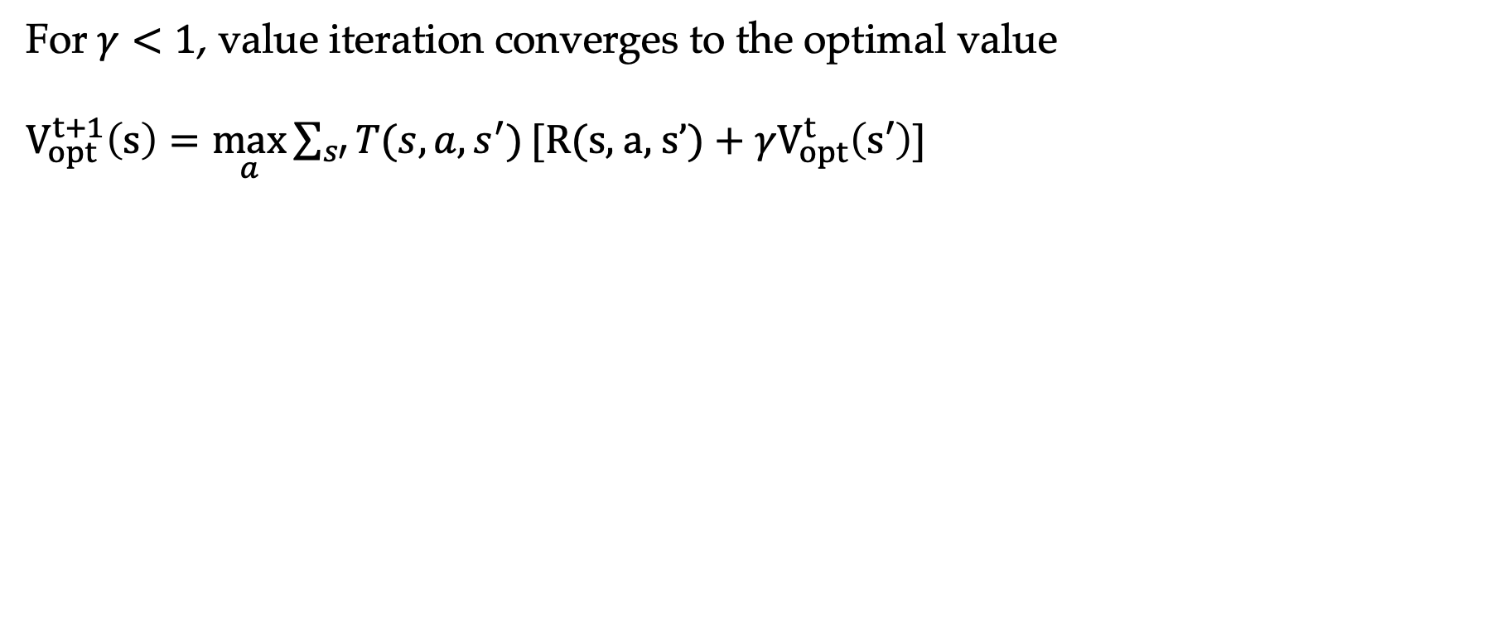
Convergence of value iteration
For$γ<1$, value iteration converges to the optimal value
$V_{opt}^{t+1}\left(s\right)=\max_{a}{\sum_{s′}{T(s, a, s^{′})}\text{[}\text{R}\text{(}\text{s}\text{, }\text{a}\text{, }\text{s}’)+γV_{opt}^{t}\left(s′\right)\text{]}}$
$$B:R^{\left|S\right|} →R^{\left|S\right|}$$
Contraction and hence convergence

Slide 10
Policy iteration
Can we iterate directly on policies instead?
Repeat
Do policy evaluation to compute
Policy iteration generally requires fewer iterations than value iteration, but each iteration involves solving a linear system (or running policy evaluation iterations)

Slide 11
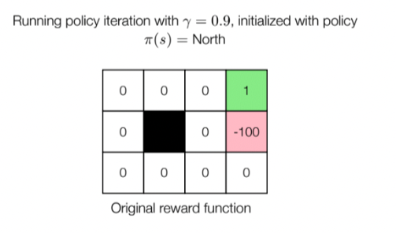
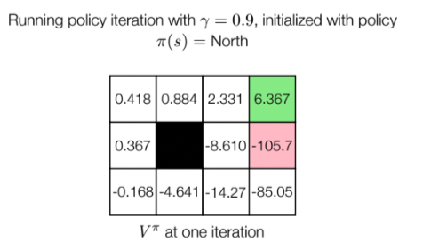

Policy iteration on gridworld

Slide 12
Reinforcement learning
Value iteration and policy iteration assumes complete knowledge of transitions and rewards
Reinforcement learning setting: Unknown transitions and/or rewards
Take actions in the world to learn about the world, with the goal of maximizing expected utility
Taking actions in the world often called “online”
Suppose I want to learn to walk

Slide 13
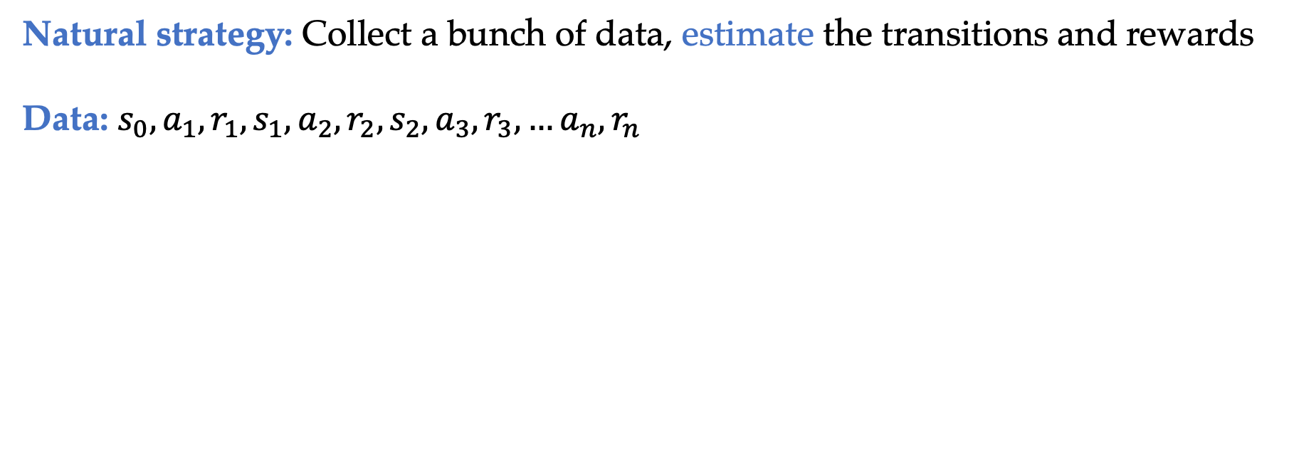
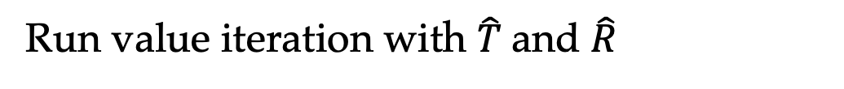
Model-based reinforcement learning
Natural strategy: Collect a bunch of data, estimate the transitions and rewards
Data: $s_{0}, a_{1},r_{1},s_{1},a_{2},r_{2},s_{2},a_{3},r_{3},…a_{n}, r_{n}$
Run value iteration with $\hat{T}$and $\hat{R}$

Slide 14
Model-based Monte Carlo
Natural strategy: Collect a bunch of data, estimate the transitions and rewards
Data: $s_{0}, a_{1},r_{1},s_{1},a_{2},r_{2},s_{2},a_{3},r_{3},…a_{n}, r_{n}$
Run value iteration with $\hat{T}$and $\hat{R}$
What can go wrong here?

Slide 15
Data collection
You choose how to collect your data in reinforcement learning
Typically called “exploration” where we want to make sure we gather relevant data
Contrasts with supervised learning where the data just comes from the underlying distribution

Slide 16
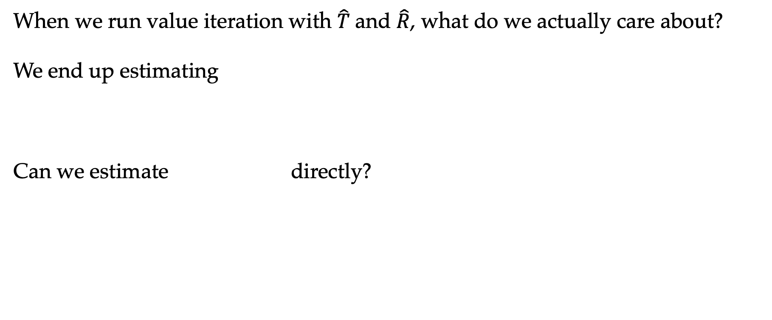
Model-based to model-free
When we run value iteration with $\hat{T}$and $\hat{R}$, what do we actually care about?
We end up estimating
Can we estimate directly?

Slide 17
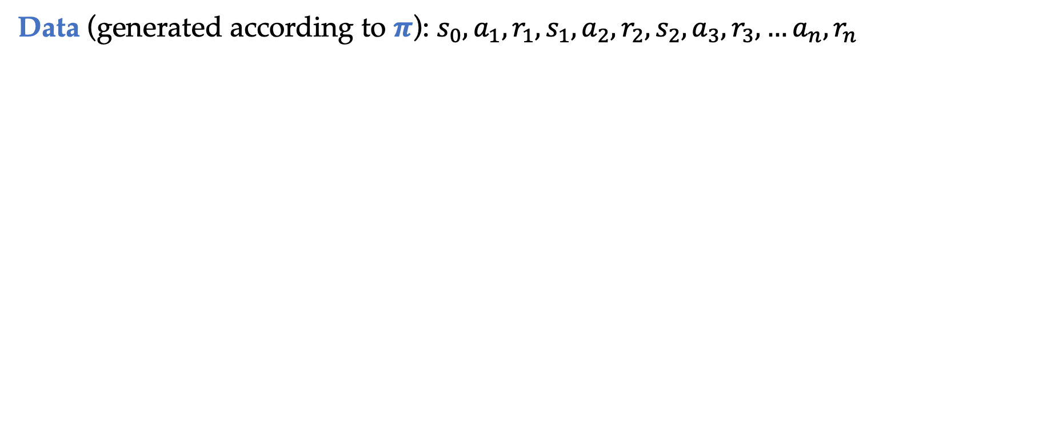
Model-free Monte Carlo
Data (generated according to $π$): $s_{0}, a_{1},r_{1},s_{1},a_{2},r_{2},s_{2},a_{3},r_{3},…a_{n}, r_{n}$
Never estimating transition probabilities or rewards

Slide 18

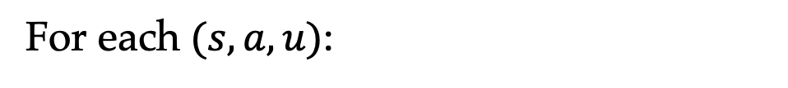
Model-free Monte Carlo
For each $(s, a, u)$:
What is $η$?
Can view Model-free Monte Carlo as making updates to the estimate based on data $u$

Slide 19
Model-free Monte Carlo
The ”data” $u$ comes from one observation of a trajectory and hence can be very noisy
Is there a way to reduce the noise in updates?
Bootstrapping from previous estimates
Suppose we observe $(s, a, r, s’)$ in the data
SARSA algorithm

Slide 20
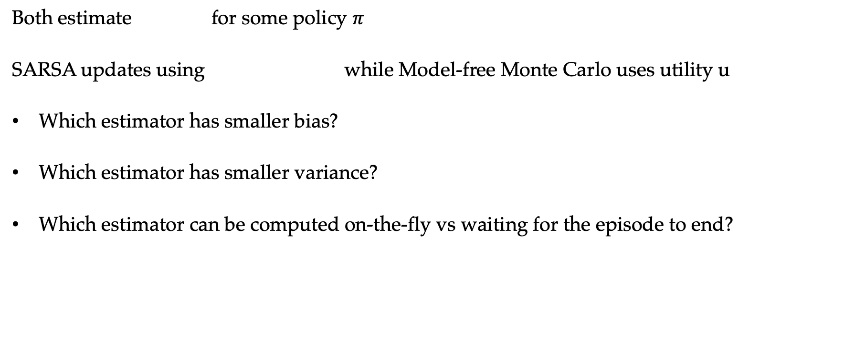
SARSA vs Model-free Monte Carlo
Both estimate for some policy $π$
SARSA updates using while Model-free Monte Carlo uses utility u
Which estimator has smaller bias?
Which estimator has smaller variance?
Which estimator can be computed on-the-fly vs waiting for the episode to end?

Slide 21
Q-learning
So far we talked about policy evaluation (estimating )
What about the optimal policy?
We extend the ideas of SARSA and Model-free Monte Carlo
Have we done something similar before?

Slide 22
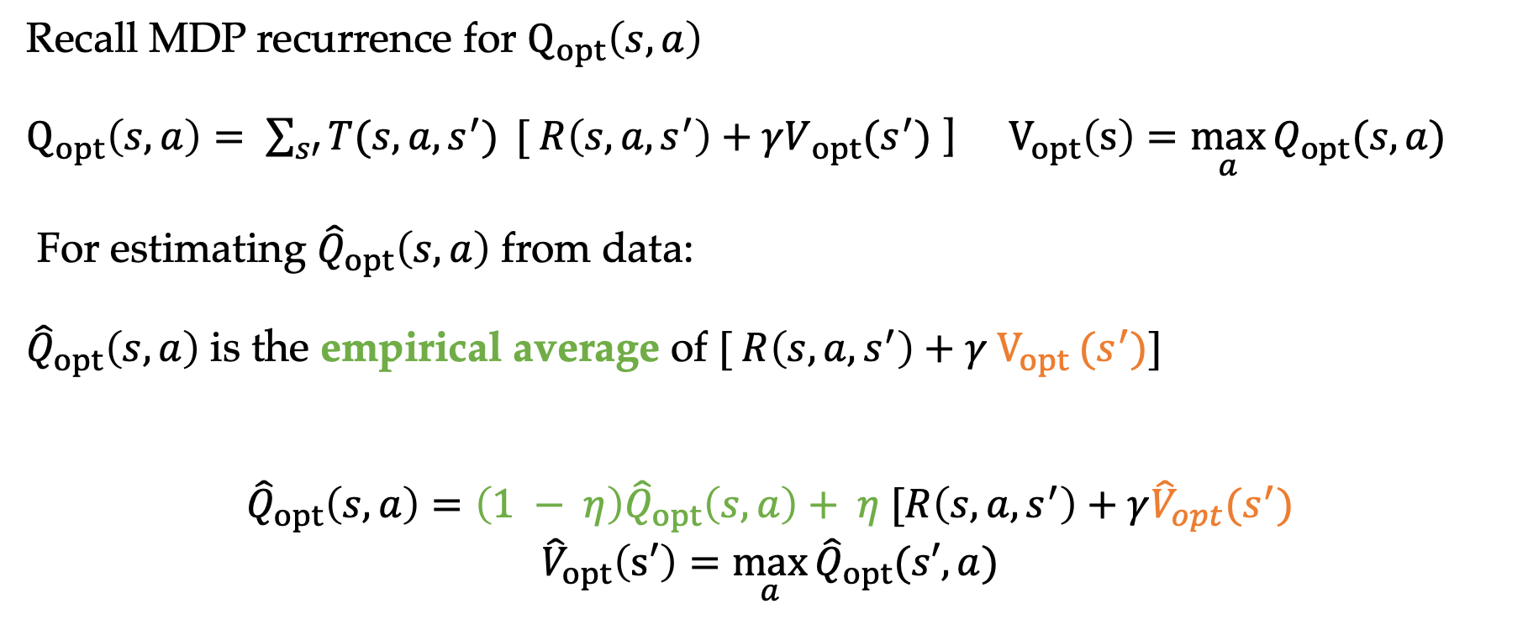
Q-learning
Recall MDP recurrence for $Q_{opt}\left(s,a\right)$
$Q_{opt}\left(s,a\right)= \sum_{s′}{T(s, a, s^{′})} {[ R\left(s, a, s^{′}\right)+γV}_{ opt}(s^{′})$ ] $V_{opt}\left(s\right)=\max_{a}{Q_{opt}(s, a)}$
For estimating ${\hat{Q}}_{opt}\left(s,a\right)$ from data:
${\hat{Q}}_{opt}\left(s,a\right)$ is the empirical average of ${[ R\left(s, a, s^{′}\right)+γ V_{opt}}_{ }(s^{′})]$
$${\hat{Q}}_{opt}\left(s,a\right)=\left(1 − η\right){\hat{Q}}_{opt}\left(s,a\right)+ η [R\left(s, a, s^{′}\right)+γ{\hat{V}}_{opt}(s^{′})$$
$${\hat{V}}_{opt}\left(s′\right)=\max_{a}{{\hat{Q}}_{opt}(s′, a)}$$

Slide 23

Q-learning vs SARSA
For each (s, a, r, s’):
For each (s, a, r, s’):
Following same policy $π$
Effectively following a different “optimal” policy

Slide 24
On-policy vs off-policy
On-policy: evaluate or improve the data-collecting policy
Off-policy: evaluate or learn the optimal policy using data from different policy
Classify into on-policy or off-policy:
Model-based Monte Carlo
Model-free Monte Carlo
SARSA
Q-learning

Slide 25
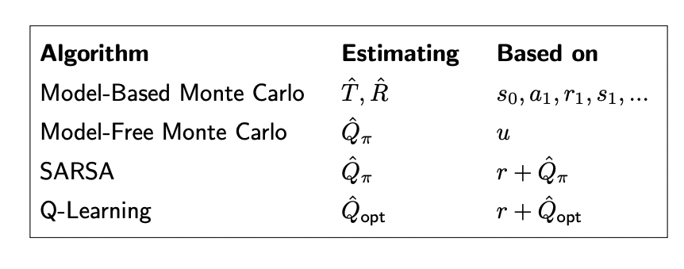
Summary of RL algorithms

Slide 26
What exploration policy to use?
Greedy:
Random:
Efficient but can be inaccurate depending on initial values --- don’t correct initial estimates
Sweet spot is a combination of the two
Accurate (doesn’t get swayed by initial values) but inefficient

Slide 27
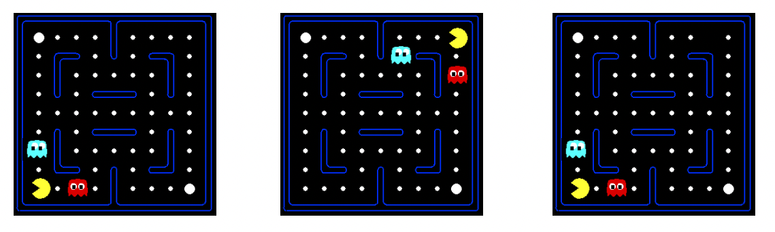
Generalization across states
So far, all estimates ${\hat{Q}}_{opt}(s, a)$ are stored as a table of values
When does this become inefficient?
Suppose we estimate that this state is bad
We want to avoid these other states too..

Slide 28
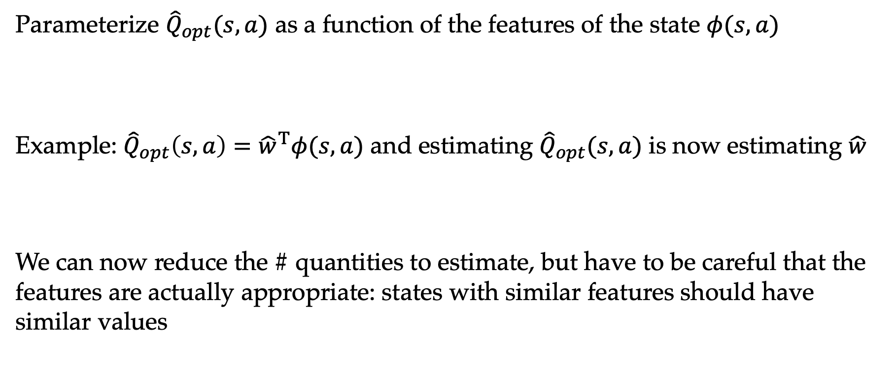
Generalization across states
Parameterize ${\hat{Q}}_{opt}(s, a)$ as a function of the features of the state $φ(s, a)$
Example: ${\hat{Q}}_{opt}\left(s, a\right)={\hat{w}}^{T}φ(s,a)$ and estimating ${\hat{Q}}_{opt}(s, a)$ is now estimating ${\hat{w}}^{}$
We can now reduce the # quantities to estimate, but have to be careful that the features are actually appropriate: states with similar features should have similar values

Slide 29

Online least squares view of Q-learning
For each (s, a, r, s’):
For each (s, a, r, s’):
Equivalent to gradient descent on
Target $t$

Slide 30
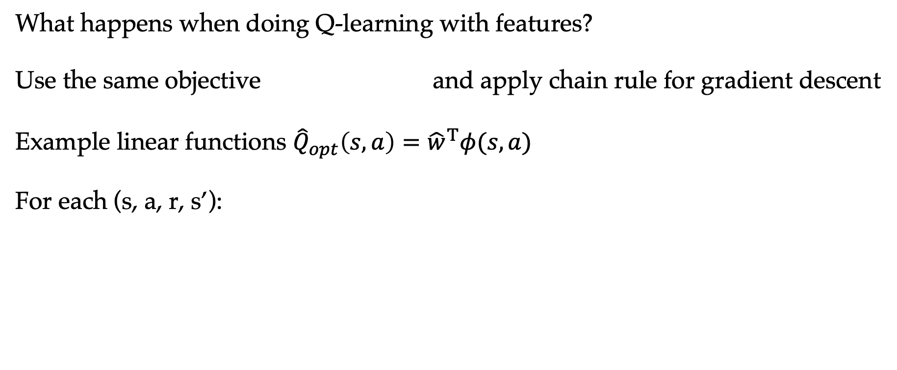

Online least squares view of Q-learning
What happens when doing Q-learning with features?
Use the same objective and apply chain rule for gradient descent
Example linear functions ${\hat{Q}}_{opt}\left(s, a\right)={\hat{w}}^{T}φ(s, a)$
For each (s, a, r, s’):
Target $t$

Slide 31
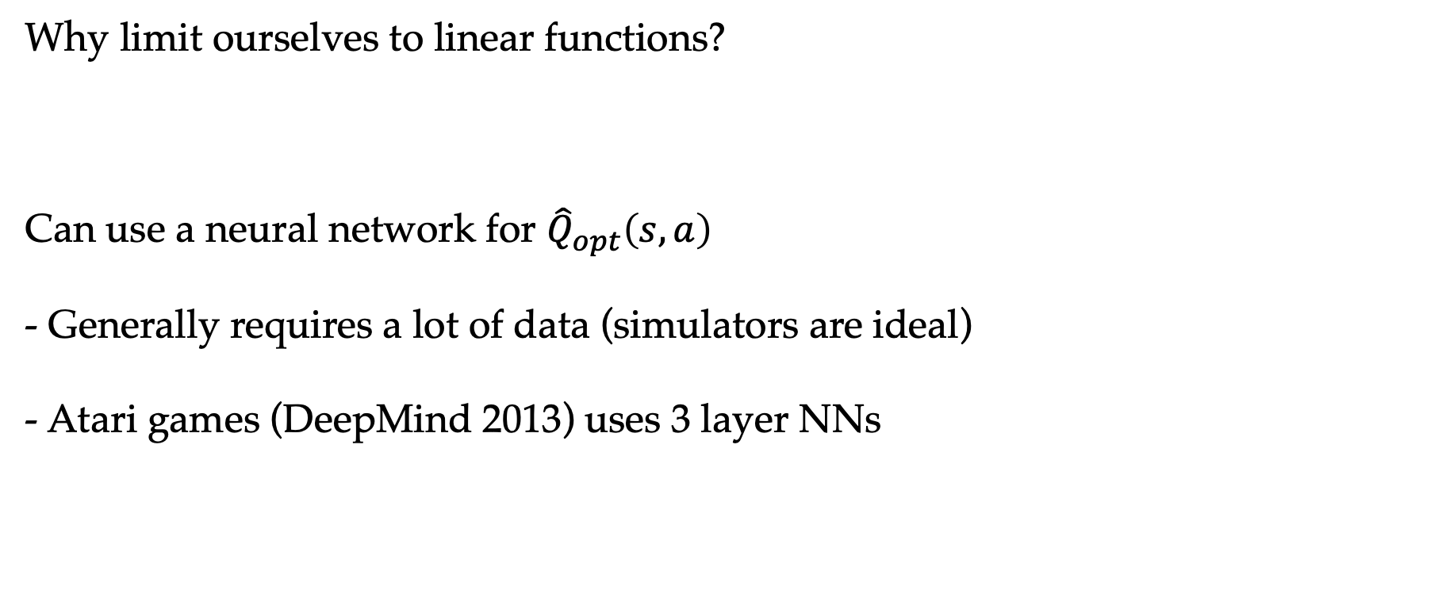
Deep RL
Why limit ourselves to linear functions?
Can use a neural network for ${\hat{Q}}_{opt}\left(s, a\right)$
- Generally requires a lot of data (simulators are ideal)
- Atari games (DeepMind 2013) uses 3 layer NNs

Slide 32
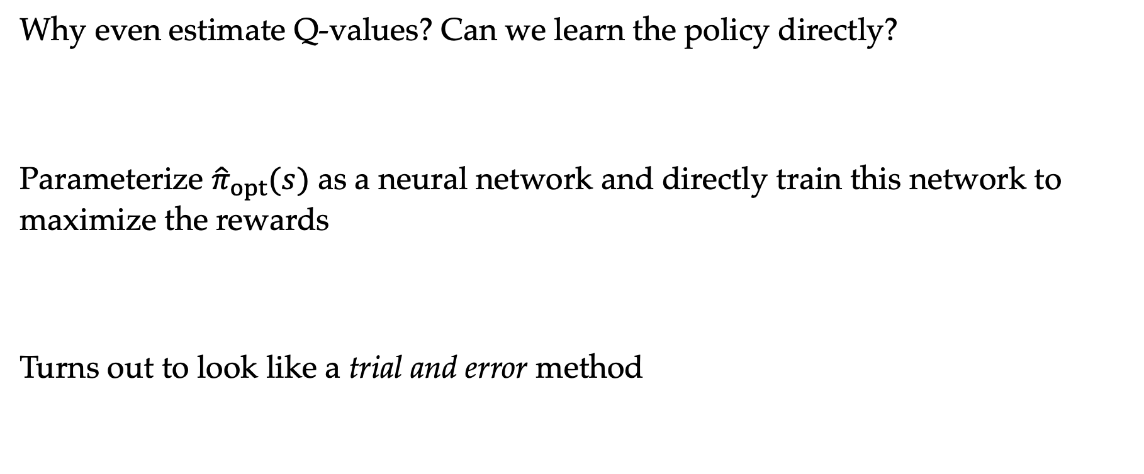
Policy gradients
Why even estimate Q-values? Can we learn the policy directly?
Parameterize ${\hat{π}}_{opt}(s)$ as a neural network and directly train this network to maximize the rewards
Turns out to look like a trial and error method

Slide 33
Summary
Markov Decision Processes (known transitions, rewards)
Policy evaluation
Value iteration
Policy iteration
Reinforcement learning (unknown transitions, rewards)
Model-based and model-free monte Carlo
Bootstrapping (SARSA)
Q-learning (with and w/o function approx)
Policy gradient

Slide 34
Coming up…
So far we’ve assumed the (known or unknown) world is “random”
Things are not actively adapting to what we do
When is this NOT the case?

